Slide 1
Business View on eCTD v4.0
Advantages and challenges when considering implementation to overcome constrains of the current eCTD specification

Slide 2
Advantages of eCTD v4.0 for Regulators
Internationally harmonized common rules to create and handle an electronic submission are provided. EU regional requirements are requiring no specific software code anymore.
Simplification of all life cycle activities including flexible implementation of new submission requirements or modifications of the granularity of presented contents.
Submitted documents can be re-used for example in procedures such as work-sharing, PSUR submissions, DCP/ MRP.
One transition mapping message to allow continuous use of already submitted contents.
Automation of administrative processing is properly supported.
Much less maintenance effort for submission management and reviewing tools is necessary. Electronic submission required for regulated product types other than human medicinal products (e.g. for medical devices, clinical trial applications or veterinary medicinal products) can be easily supported
eCTD 4.0 can make it possible to indicate that submitted content has received agency assessment, and what the outcome was. Such information could save further review and assessment work.

Slide 3
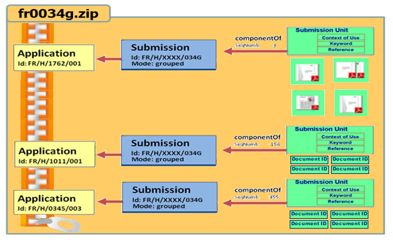
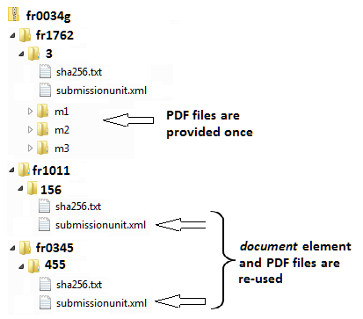
Grouped Submissions (all kinds of grouping, worksharing, PSUR, ASMF)
Example:
The submissionunit.xml will contain contextOfUse elements only for one application and references the document element UUIDs included from e.g. fr1762 submissionunit.xml by which the files are provided
Provision of separate submissionunit.xml files of involved applications, submitted in one container to get all information same time

Slide 4
With eCTD v4.0, you can… (for industry, but also with benefits for regulators)
Re-use documents submitted previously,
Correct information (e.g. display name or document title) easily,
Group documents within a CTD section in a consistent way across ICH regions,
Change document granularity while maintaining life cycle relationships,
Set the order of documents within a CTD section,
Identify submission content (e.g., datasets) for additional processing, and
Transition current content in v3.2.2 to v4.0 and continue eCTD life cycle in v4.0.

Slide 5
Pre-requisites
The benefit-cost-ratio needs to be evaluated.
Agencies which are currently don’t use an eCTD reviewing tool need to implement or need to have access to at least a simple viewing tool.
Considering that IT developments will move from a document based towards a data based submission an impact analysis should be performed on how eCTD v4.0 will interact with IDMP implementation, application dataset usage for eAF or product databases for medicinal products.

