Slide 1
eSubmission Web Client XML delivery file – new functionality
Changes introduced in v3.5.0.0
Presented by Hanna Palyszka on 5 July 2018

Slide 2
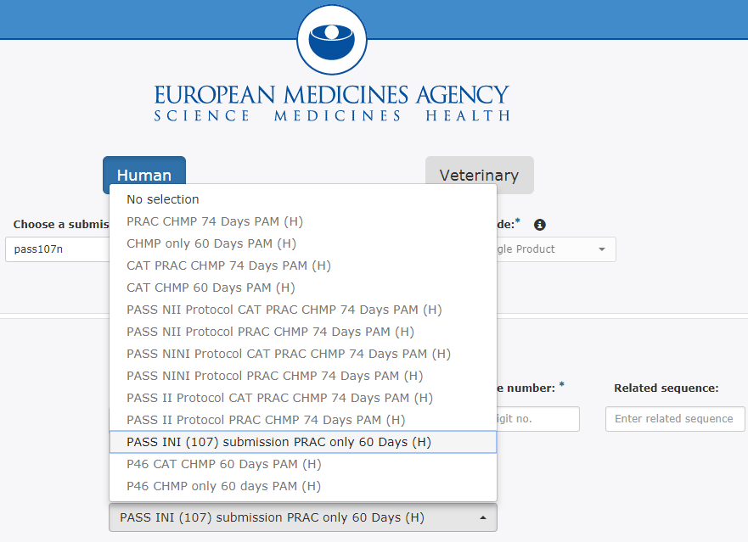
1. PASS - Filtered PAM Code lists (SD-134043)
For both Human submissions.
When the user selects any of the PASS submission types i.e.
PASS107n
PASS107o
PASS107q
The system shall now only allow selection of PAM codes that are relevant for PASS submissions.
1

Slide 3
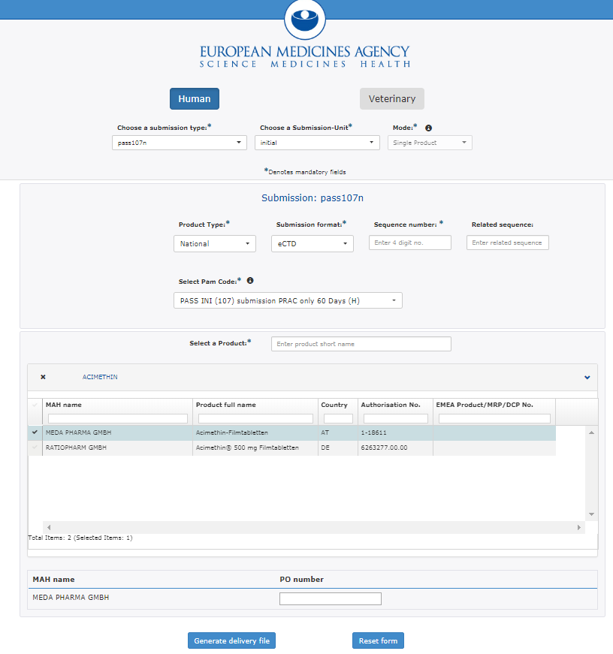
2. PASS107 - PO Number (SD-114348)
For Human submissions only.
When the user selects any of the PASS submission types i.e.
PASS107n
PASS107o
PASS107q
and Submission unit is “initial” and the Product type is “National”.
Users may now add a Purchase Order (PO) Number for each selected Marketing Authorisation Holder.

Slide 4
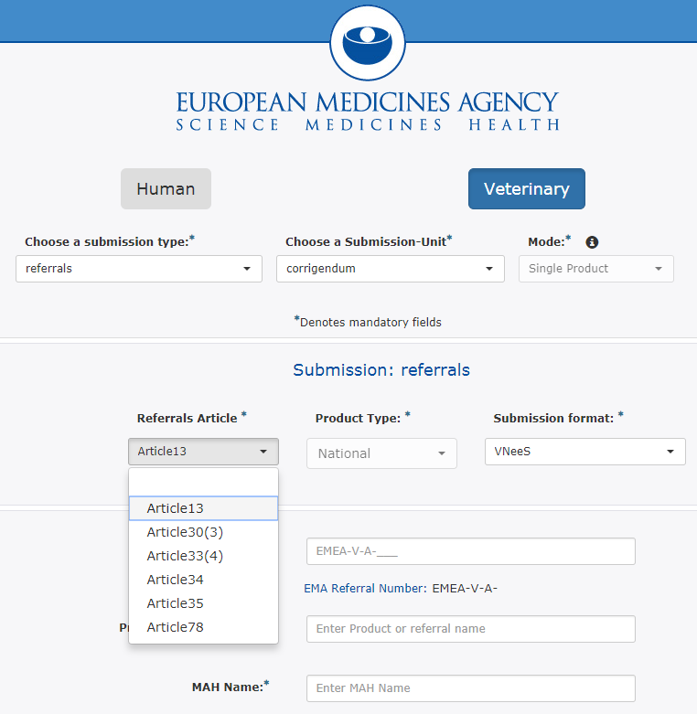
3. Referrals - Filtered Product Type (SD-63491)
For Veterinary submissions only.
When the user selects a referral submission types and a Referrals Article.
The system shall now only allow selection of a Product Type that is relevant for the selected Referral Article. This will be as follows:
Article 13 -> National (only)
Article 30(3)-> Centralised or National
Article 33(4) -> National (only)
Article 34 -> National (only)
Article 35 -> National (only)
Article 78 -> National (only)
3

Slide 5
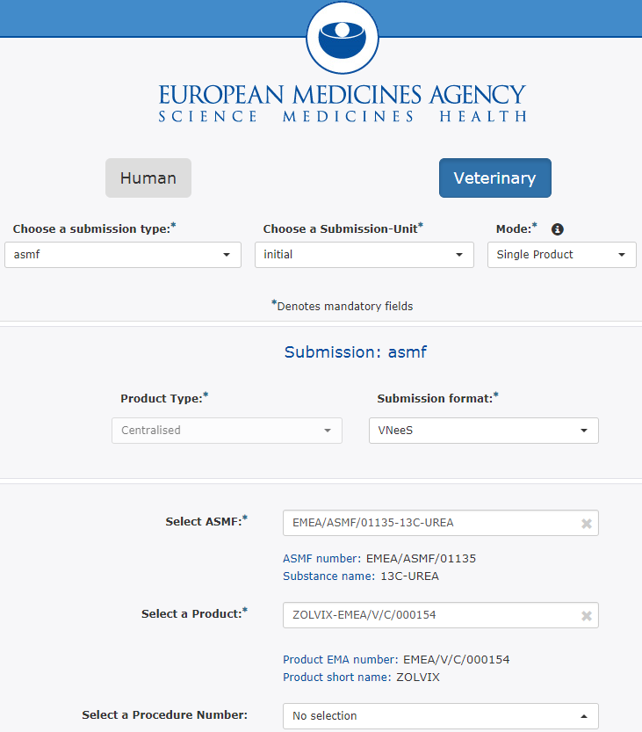
4. Select Procedure Number in ASMF Vet (SD-157644)
For Veterinary submissions only
Users can now select from a predefined list of procedure numbers to reference their ASMF submissions. This is applicable for all ASMF submissions types.
This is aligning with how Human procedure numbers can be linked to ASMF submission.
4

Slide 6
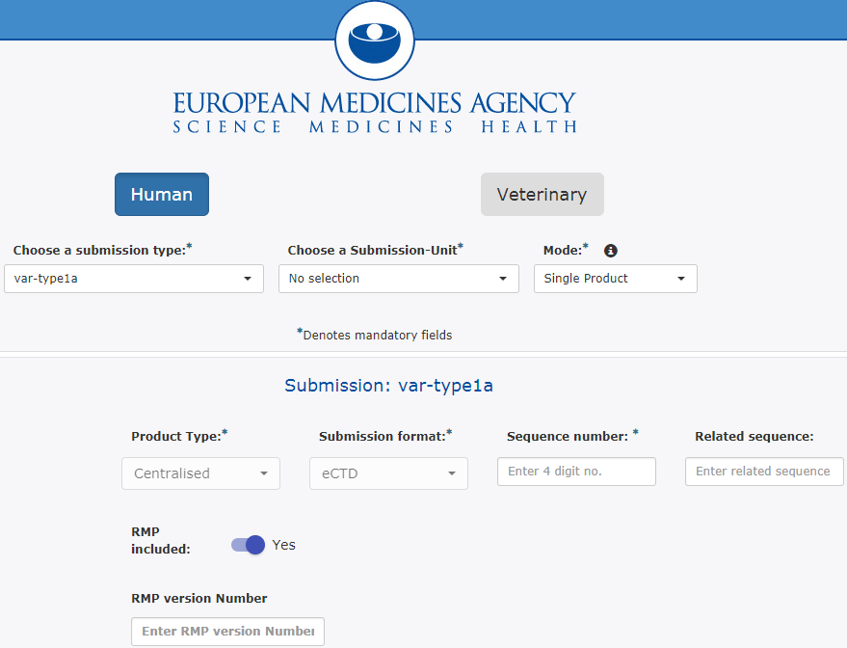
5. Identify if an RMP is included during a Variation (SD-160011 )
For Human submissions only.
Users can now identify whether a Risk Management Plan is included for the following type of submissions:
Variation Type IA
Variation Type IAIN
This is in addition to the below:
MAA
Variation Type IB
Variation Type II
Extension
PAM
Renewal
5

Slide 7
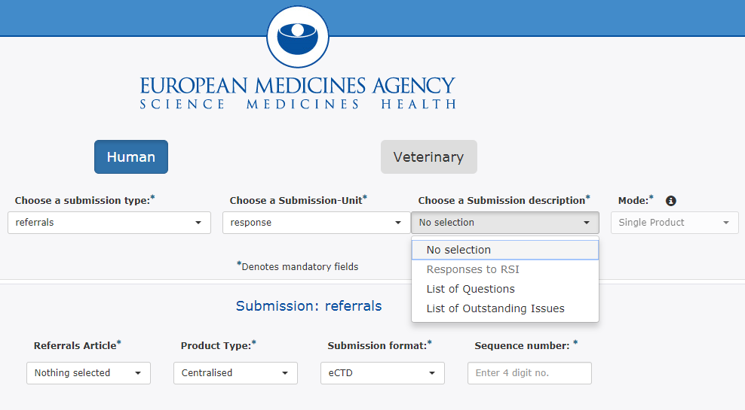
6. Referrals – Type of Response (SD-145151)
For both Human & Veterinary submissions.
When a referral submission is selected and the submission unit is a response then the user must now indicate the type of response by selecting a value from the submission description.
6

Slide 8
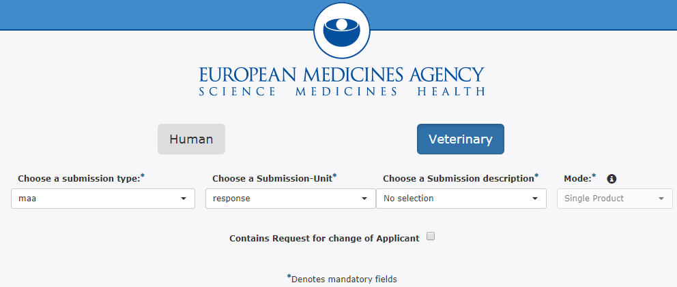
7. MAA – Brexit related request to change applicant (SD-172720)
For both Human & Veterinary submissions.
When a Marketing authorisation application submission is selected and the submission unit is a response then the user may indicate if the response contains a request to change the Applicant. If so the relevant docs should be included as part of the submission (e.g. new electronic Application Form)
7

Slide 9
8. Additional Guidance on Home page (SD-XXXXX)
When users first access the esub web UI link, they will be presented with additional guidance regarding eCTD.
8

Slide 10
Thank you for your attention
Further information
https://servicedesk.ema.europa.eu
European Medicines Agency
30 Churchill Place • Canary Wharf • London E14 5EU • United Kingdom
Telephone +44 (0)20 3660 6000 Facsimile +44 (0)20 3660 5555
Send a question via our website www.ema.europa.eu/contact
Follow us on @EMA_News
Notes:
Note: This slide is OPTIONAL. It uses the 'Closing slide' layout. Delete if not needed.

