Slide 1
How to complete an eAF based on version 1.20
Webinar for the usage of an eAF for submissions of human and veterinary applications
Presented by: Georg Neuwirther (AGES), Klaus Menges (BfArM) and Kristiina Puusaari (EMA) June 2016

Slide 2
Training topics
Introduction
Variation form
Initial MAA form human
Initial MAA form veterinary
Renewal form
General issues

Slide 3
Introduction
This presentation provides practical and technical support on the use of the Electronic Application Forms (eAFs) version 1.20.
More information can be found here: http://esubmission.ema.europa.eu/eaf/
Release Notes of version 1.20 can be found here
In addition consult the regulatory USER GUIDE FOR THE ELECTRONIC APPLICATION FORM FOR A MARKETING AUTHORISATION which is available for human medicinal products at CMDh and for veterinary medicinal products at CMDv. Both guidance documents are additionally available on the eAF website.
Note, all eAF related queries should be submitted to the EMA IT service desk portal: https://servicedesk.ema.europa.eu
Note, all procedure specific queries should be sent directly to the relevant National Competent Authority.

Slide 4
VARIATION FORM human & VET

Slide 5
VARIATION FORM human & VET: Changes to section 2 ‘products concerned’

Slide 6
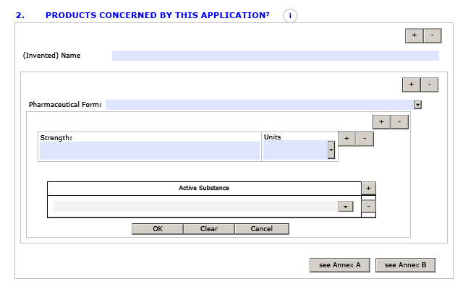
Annex A and B
more easy-to-use and logical layout
The information on products presentations concerned which used to be required as Annex (Annex A or Annex B), should now be entered within the form itself – no need for Annex A or Annex B

Slide 7
Essentials /1
Demonstration follows
Add block variation number
Add Member State

Slide 8
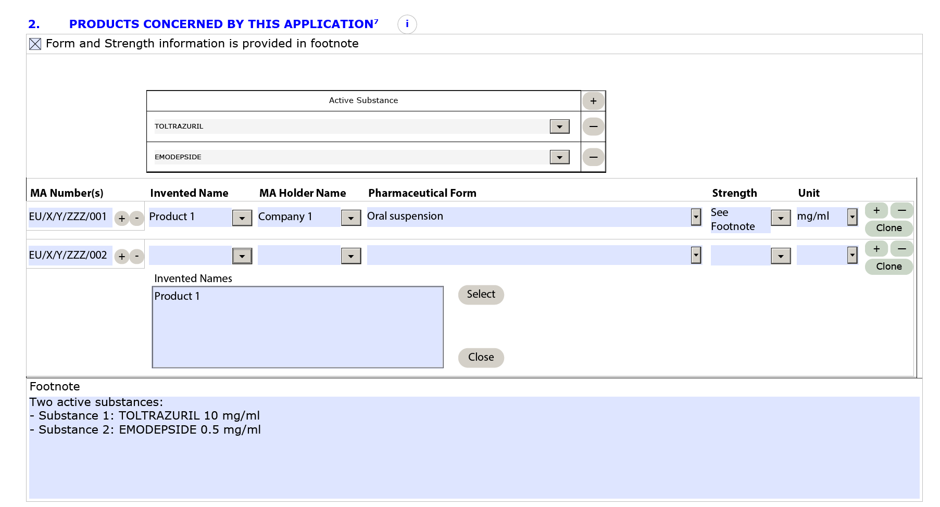
Essentials /2
Enable data field (used for fixed dose combinations / vaccines
Add fields for further
MA number in that line
Select from previously entered data
Add another line
Add another line / copy data from above

Slide 9
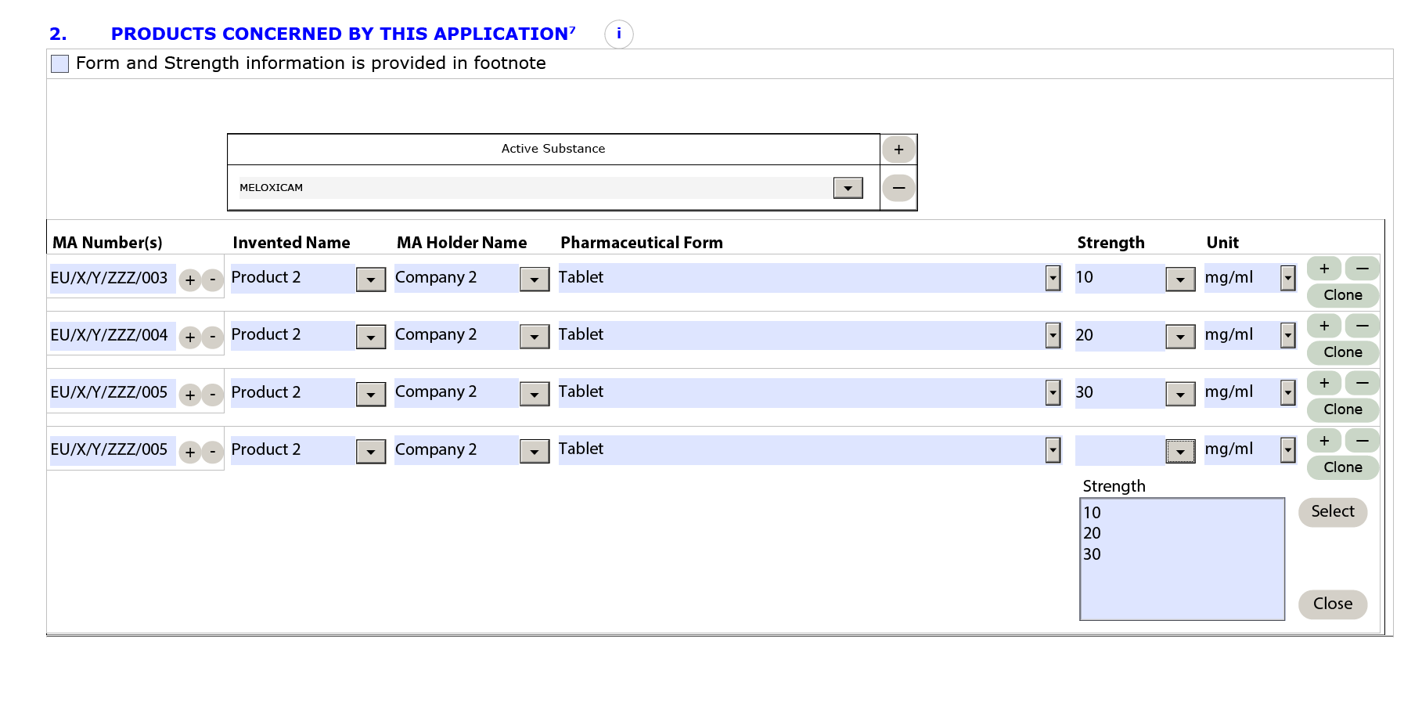
Example Strength
If your product has different strengths, from the second line of you can select strengths already entering in the first line by clicking on the dropdown buttons. Alternatively, use the clone button and only change information in relevant fields.

Slide 10
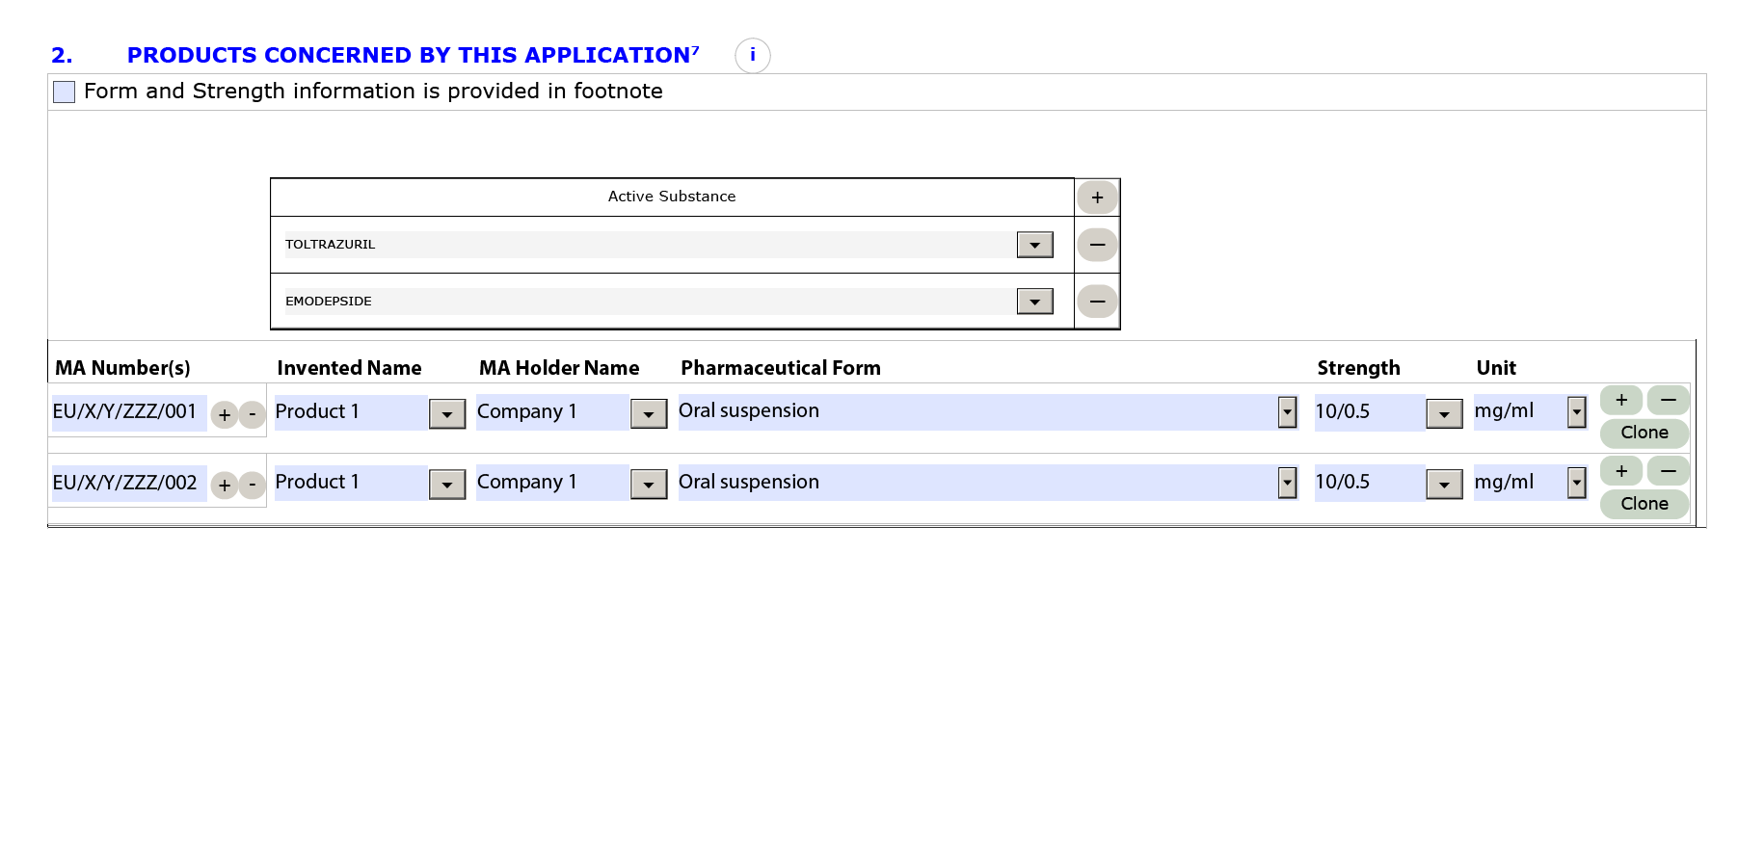
Example Strength
Strength:
For fixed dose combinations the strengths can be separated with forward slash or plus sign e.g. 100/500, 100+500, by typing substance a 100/ substance b 500
Alternatively, if the strength information is complex it may be inserted on a the footnote.
Example 1

Slide 11
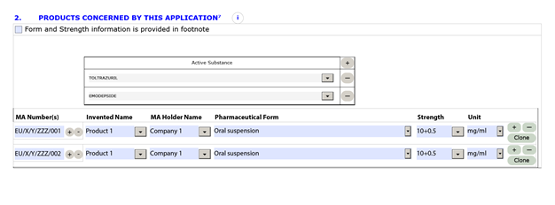
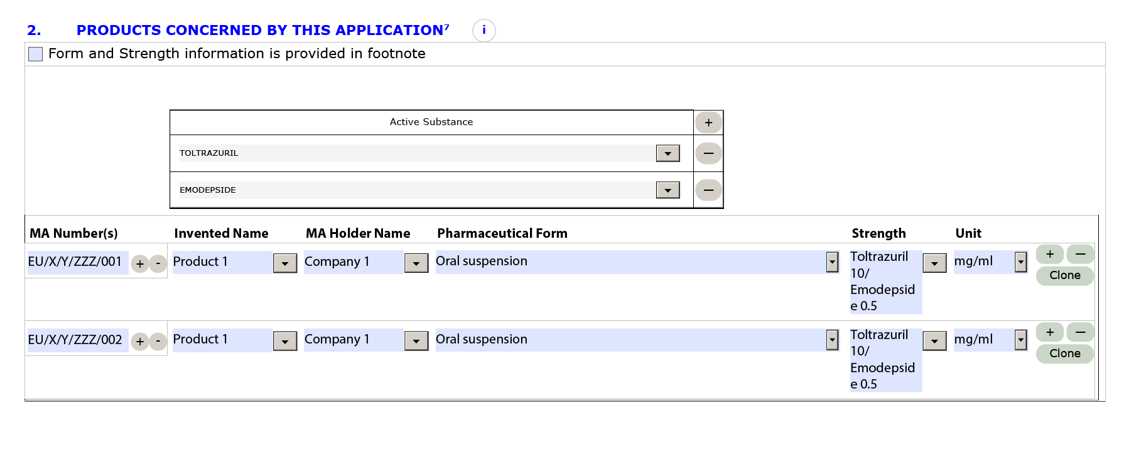
Example Strength
Example 2
Example 3

Slide 12
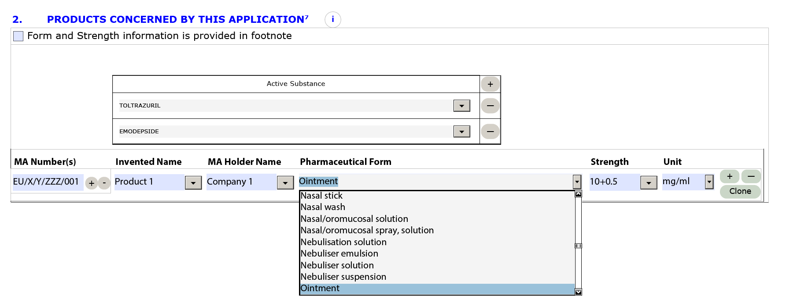
Comment List Boxes
Pharmaceutical form and Unit:
The drop down list component is unable to support multi-character filtering. You can only type the first letter of the pharmaceutical form or the unit and then scroll down the list using the arrow button or the mouse.
Example 1(pharmaceutical form):

Slide 13
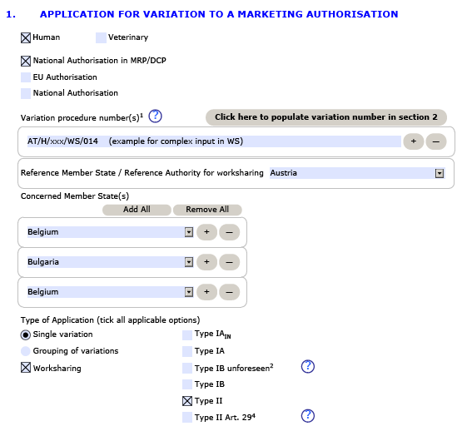
Live Demo

Slide 14
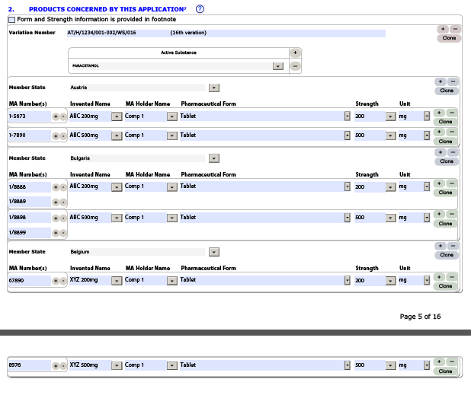
Live Demo / Result

Slide 15
Initial MAA form human

Slide 16
Topics being addressed
No hyperlinks in the form
Structure of the address fields and extended options to copy content
File name convention to support differentiation of eAF and annexes in the eCTD
eAF will not change national legal requirements on wet signatures
Member states selection of 'all' and adjustment of single entries
Structure of strength name field in value and unit of measurement
Some advice in regard to container and closure systems, material
Usage of free text fields to describe manufacturer tasks
Composition - difference between CAP and MRP/DCP/NAP - rule on which products can be covered by one MAA-form
Composition - differentiation between active substances and ingredients or different parts of a product.
Composition - explaining the new operator ‘quantum satis’ (qs)
Pharmacovigilance System

Slide 17
No hyperlinks in the form
It is underlined that the forms are secured in such manner that no change can be brought outside filling the field, i.e. no bookmarks or hyperlinks should be added, no merging with other files should be done, no comments can be brought in the pdf file.
Technically you can add bookmarks and hyperlinks in pdf files. However in eAF, it is not allowed to add any attachments/hyperlinks to the document.
Only the final signed PDF created using the electronic forms should be submitted in the relevant part of the dossier. The XML data can be extracted from the pdf file. This action will be performed by agencies when receiving the pdf form. Therefore, it is not necessary neither required to provide the XML data file separately.
If the eAF.xml is stored in the CTD (eCTD or NeeS) sequence or VNeeS submission, an error during technical validation will be reported. It is of course strongly advised against printing out the form and scanning it in

Slide 18
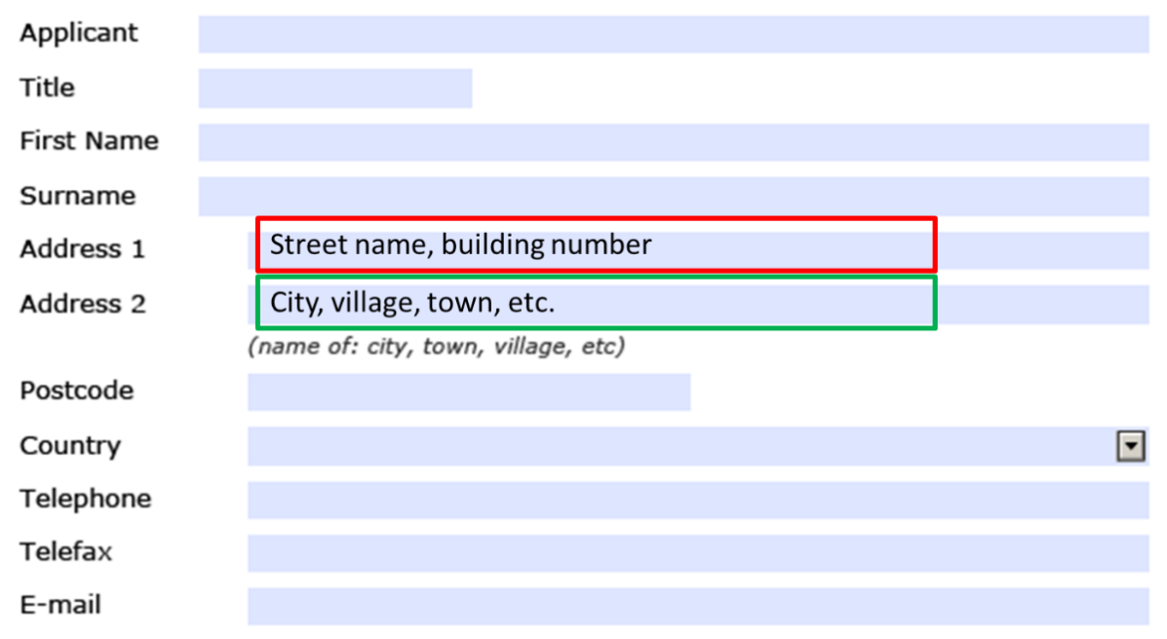
Structure of the address fields and extended options to copy content
Address details should be provided in the eAF in a harmonised way – tooltips and guidance has been added.
The same address should be entered identically when it is required in different sections of the forms. Copy contact details buttons have been included to copy data from e.g. section ‘Declaration and Signature’ into sections where same addresses may be relevant:
".

Slide 19
File name convention to support differentiation of eAF and annexes in the eCTD
For human medicinal products the file names should be
common-form-eaf-var.pdf
common-form-annex-var.pdf
The variable part should be used as outlined in the file & folder naming convention of the updated eCTD validation criteria version 6.1 rsp. NeeS validation criteria version 4.1.
19

Slide 20
eAF will not change national legal requirements on signature
Digital signatures (as opposed to scanned signatures) are not currently within the scope of this project.
An image will not work as a digital advanced or qualified electronic signature nor can replace requirements of wet signed forms.
EMA strongly recommends use of scanned image of the signature for Centralised Procedure applications.
The eAF does not change the wet signature requirements at the NCAs. Please check the national requirements for wet signatures to avoid validation issues.
In DCP/MRP an AF signed by multiple responsible persons is needed for communication with specific NCA (could be initial submission or renewal or variation). Ideally a single contact point is provided. For those NCAs that require multiple contact persons please include a separate annex with the contact details.

Slide 21
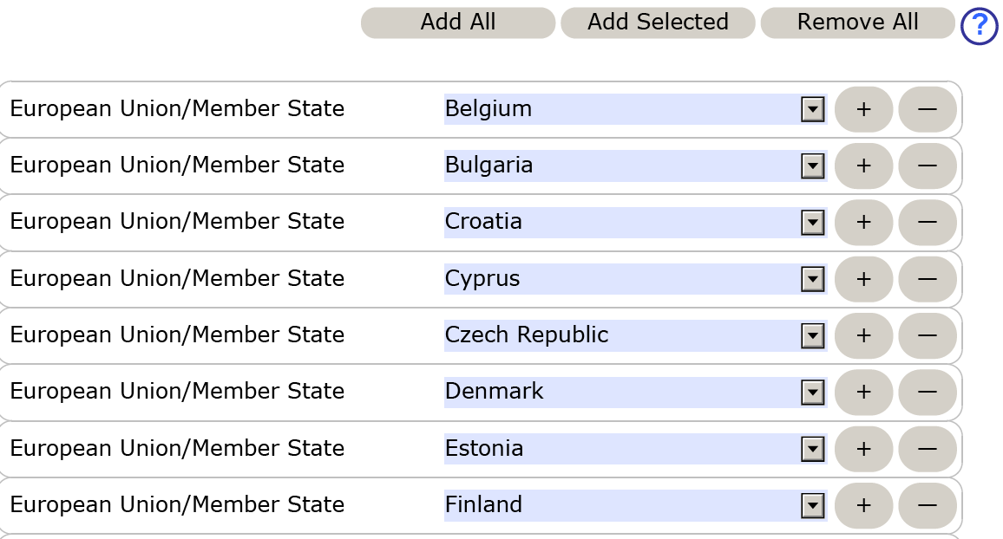
Member states selection of 'all' and adjustment of single entries
In section 2.3 and 2.4 and in case of MRP / DCP, you can now include previously selected member states in one go
It depends whether adjustment from the complete list or by adding single member states is the most effective way of working.

Slide 22
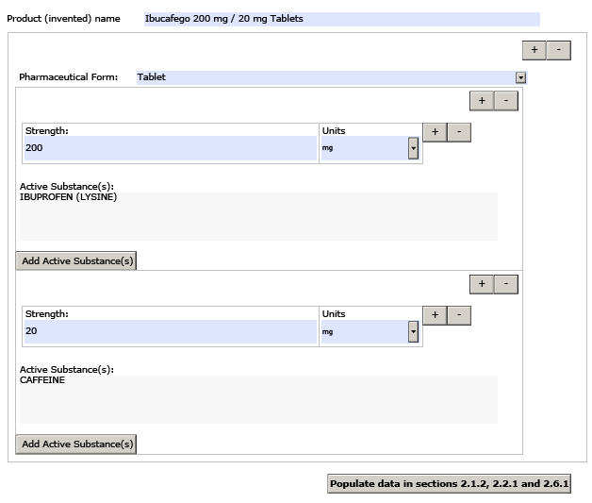
Structure in strength and unit of measurement
The strength(s) will now be entered in a structured way as long as no more than three pharmacologically active ingredients being employed.
The units of measurement will be selected from a controlled list according to standard terms as provided by EDQM.
The active ingredient data fields need to be duplicated as necessary.
In case of another pharma- ceutical product the respective frame needs to be repeated.
All details can be copied into other sections

Slide 23
Usage of free text fields to describe manufacturer tasks
A free text field is included so that a description of the partial product (e.g. vial with solvent, vial with powder, solvent etc.) can be included if necessary to indicate which part of the product a specific manufacturer produces. This field is optional and can be left empty.
vial with powder

Slide 24
Rule on how several products can be covered by one MAA-form
For MRP/DCP new applications and renewals, a single form should be submitted for each strength and pharmaceutical form (and not for each country).
This is contrary to the centralised where a combined AF for all strengths and pharmaceutical forms is possible.
For variation applications you can combine several products in all procedure types.

Slide 25
Reference to the pharmaceutical product
The chosen active substance(s) is/are automatically displayed in section 2.6.1 on the ‘Name of active substance field(s)’. You are able to add additional information on the active substance as well as all excipients in a separate list.
To interpret the composition correctly the reference of counting must be stated in the first line. All quantities of substances are referring to a defined quantity of the specified pharmaceutical form, e.g. 1 (unit) of tablets or 100 (ml) of a solution.

Slide 26
Active substances and ingredients of different parts of a medicinal product
In case of two or more different pharmaceutical products are offered by the medicinal product (e.g. a blister chart with two or more sections) the entire section 2.6.1 may be multiplied or within the composition a second part will be described and the below indicated free text field should indicate that another tablet is described.
Free text field for additional description or qualifying
26

Slide 27
Composition
In the leading free text field, you should add a qualifying like ‘calculated as’
The operator ‘qs’ can now be selected with or without an additional value depending from manufacturing requirements
Calculated as
Ibuprofen
Operator-Value-UoM
If you select ‘range’, the value field will be spilt into lower and upper value:

Slide 28
Salt / hydrate forms
Select the active substance(s) in ‘Declaration’ section and use ‘populate’ button to replicate the information across the form.
Occasionally a salt or hydrate format is required in sections 2.2.1 and 2.6.1 and this can be added using a workaround solution by adding this additional form via ‘excipients’ section, returning to 2.2.1 and 2.6.1 and selecting the required form from the list and returning to excipients section to deleted the salt/hydrate form from excipients section.
‘populate’ button must not be used after the workaround has been used.
Details of the workaround solution are explained in the Q&A document Q.47 http://esubmission.ema.europa.eu/eaf/docs/eAF%20Question%20and%20Answers%2014.6.2016.pdf

Slide 29
Container and closure systems, material
For container you need to select from a catalogue the respective value (presumably the catalogue is not complete).
The material is a free text field, but it is advisable to use known standard abbreviations for chemical names, such PVC, HDPE, etc.
For closure systems and administration device you need to select from a catalogue the respective value (presumably the catalogue is not complete).

Slide 30
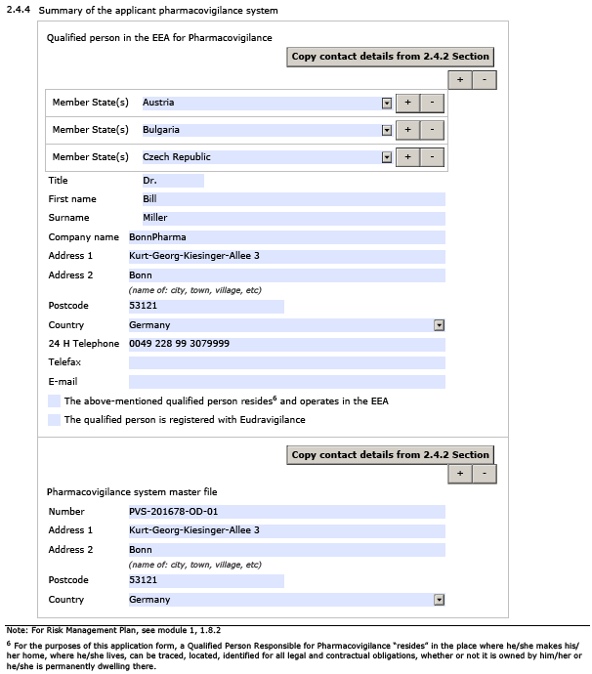
Pharmacovigilance system
For the section 2.4.4 Summary of the pharmacovigilance system, in a community procedure with more than 1 MAH the section “Qualified Person in EEA for Pharmacovigilance ” can be multiplied for more than one QPPV. Also the location of the Pharmacovigilance system master file can be multiplied independently. If the location is the same for all Member States, the Member states need to be added in the first box. If this is not the case, the entire section need to be copied. In this case section 2.4.4 needs to be repeated as different PV master files will be maintained. For each system the QPPV may be identical.

Slide 31
Initial MAA form veterinary

Slide 32
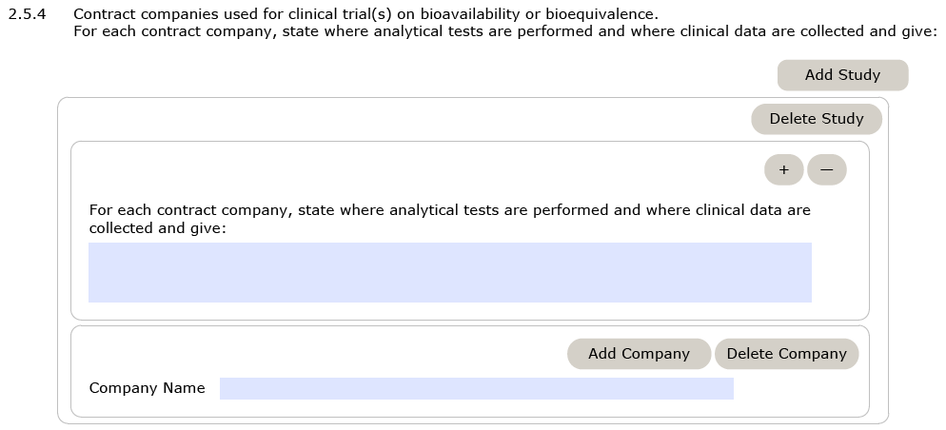
Amendment of section 2.5.4:
Heading previously read: “Contract companies used for clinical trial(s), bioavailability or bioequivalence trials”
Now: “Contract companies used for clinical trial(s) on bioavailability or bioequivalence”

Slide 33
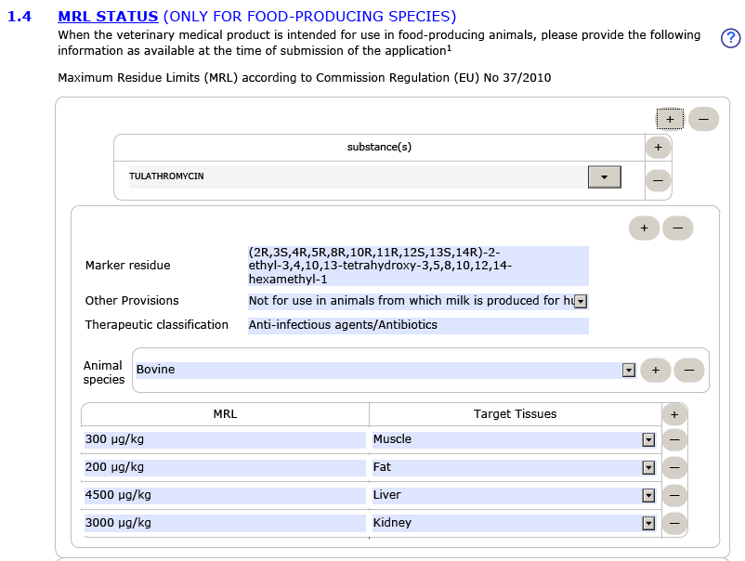
Tips for section 1.4 MRL:
How to delete information from the whole section:
Step 1: add a new blank section first by pressing the highest “+” button
Step 2: you can now delete the first section by pressing the highest “-” icon

Slide 34
Tips for section 1.4 MRL:
In case of non-food producing species:
Currently you still need to enter a substance and select “Not applicable”, however this field shall no longer be mandatory in the hotfix version.

Slide 35
RENEWAL FORM human & VET – see known issues below

Slide 36
GENERAL ISSUES

Slide 37
Where to find eAFs?
Option 1 - link to eAF webpage from Eudralex page
Notice to Applicants (European Commission)
http://ec.europa.eu/health/documents/eudralex/vol-2
http://ec.europa.eu/health/documents/eudralex/vol-6/index_en.htm
Note: The Word-AFs have been removed from the Eudralex website!
Option 2
eSubmission Homepage (EMA)
http://esubmission.ema.europa.eu/eaf/index.html

Slide 38
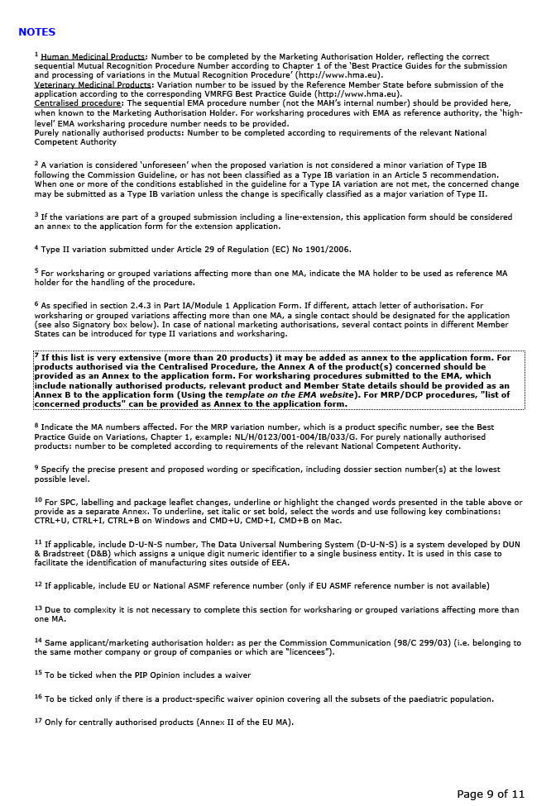
Scenario:
Accessing footnotes
Demonstration follows

Slide 39
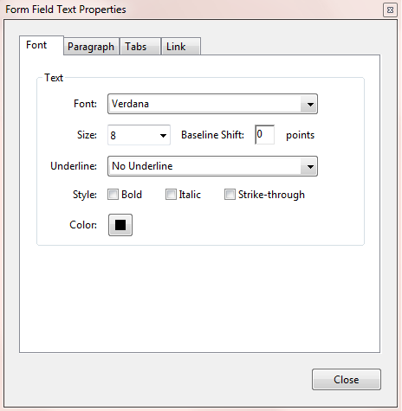
Scenario:
Formatting text in free text fields such as the ‘Present and Proposed table’ in the variation form
Demonstration follows

Slide 40
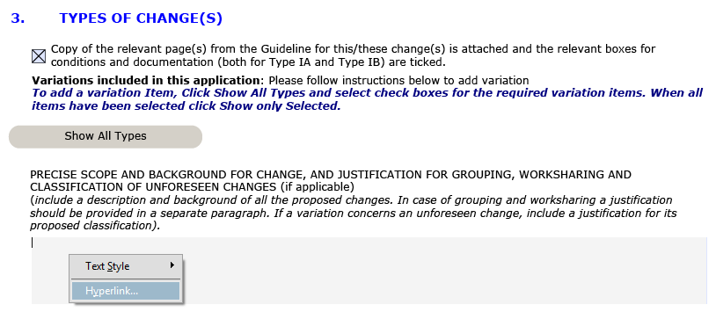
To access the text formatting function, right-click inside the relevant text field and choose the Hyperlink option. This will open the dialog box for linking and formatting shown in the previous slide.

Slide 41
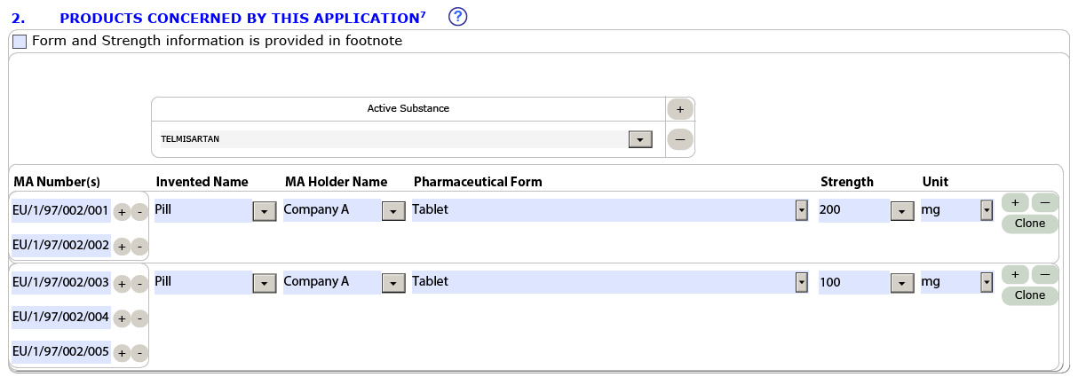
Known issues
Use of section 2 footnote in the variation form:
Yes:
The information on products/presentations affected by the variation should be listed in the table provided wherever possible.

Slide 42
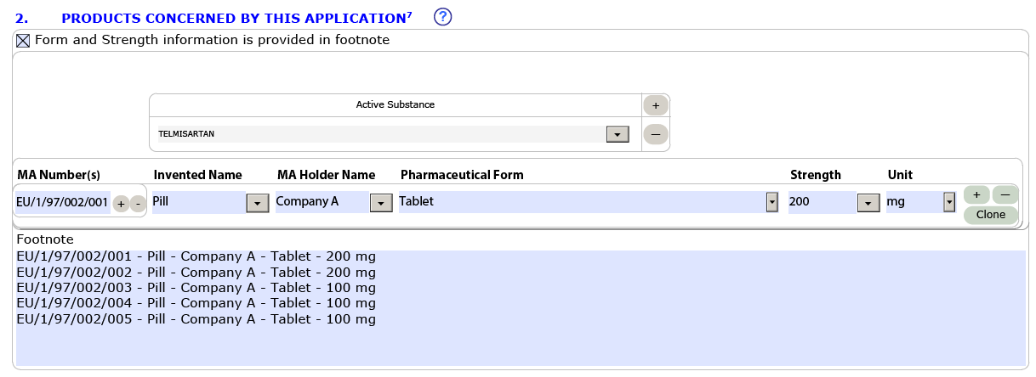
Known issues
Use of section 2 footnote in the variation form:
No:
The footnote should be used only for fixed-dose combinations and vaccines where the expression of strength is more complex than what can be provided in the standard table.

Slide 43
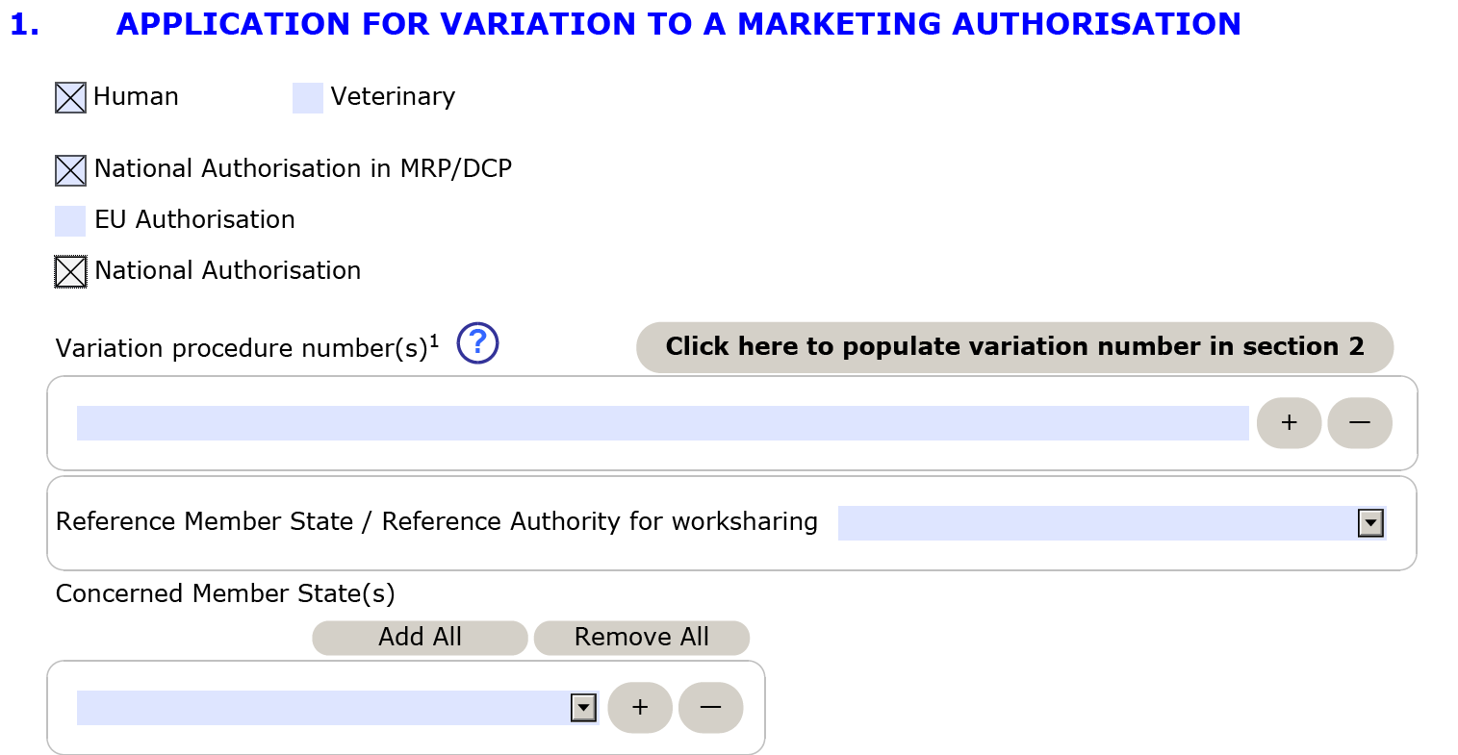
Known issues
National worksharing variations and selection of Members States:
A error in the business rules of the variation form doesn’t allow the entry of MS for National worksharing variations.
As a workaround, please tick both, National authorisation in MRP/DCP and National Authorisation tickboxes.
This issue will be fixed in the next eAF release planned March/April 2017

Slide 44
Known issues
Complete and sign using Adobe Reader, not Adobe Acrobat.
NCAs can view using Reader or Acrobat
All forms must be signed and locked using Adobe Reader. If the forms are locked using Adobe Acrobat and the receiving regulator opens the form using Reader the form appears unlocked with red boxes.
This is an Adobe issue i.e. EMA is not able fix this issue.

Slide 45
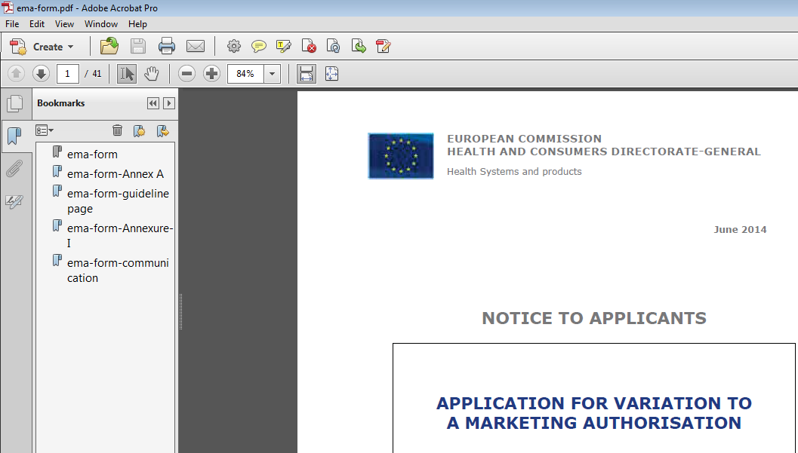
Known issues
Bookmarks cannot be used as they prevent locking of the form.
Bookmarks must not be used as they prevent the proper locking of the form and will result in rejection by the receiving regulator

Slide 46
Known issues
In renewal form, after selecting all CMS, one has to again select from the whole list of countries the Member States in which the product is marketed.
This has been solved by introducing ‘Add selected’ function which repeats the already selected list of RMS and CMS.

